Slide 1
Youth Development Strategy Open House Information Session
Presentation by:
Dr. Shukri Olow
David Gistarb
*Please note that there are notes in the ‘notes’ section below*

Slide 2
AGENDA
What we will cover today:
What is Best Starts for Kids?
Brief Overview of the Youth Development Strategy
What’s unique about this strategy?
Brief Overview of the Youth Development RFP
Questions and Answers

Slide 3
VISION
We want to see more babies born healthy, more kids thrive, and more young people grow up to be happy, healthy, successful adults.
Notes:
Building strength and resilience
Most comprehensive approach to child development in the nation.
More babies born healthy, more kids thrive, and more young people happy, healthy, successful

Slide 4
HOW DO WE DO IT?
EARLY INTERVENTION
POLICY & SYSTEMS CHANGE
PROMOTION
PREVENTION
Notes:
So how do we do it?
Increase the good, decrease the bad, intervene when needed
Promotion: begins before birth and throughout life. Increasing positive resources, relationships, opportunities, and environments available
Prevention: preventing things like stress, unsafe environments, or insufficient opportunities
Intervene early: support children and young people who need more resources
Policy and systems change: all communities can thrive and prosper
Best Starts will invest on average $65 million per year

Slide 5
What makes the Youth Development Strategy Unique?
Equity and Social Justice Lens
Promotion Strategy
Notes:
One of the unique aspects of Youth Development strategy is that it spans four program areas with a vast array of services provided Countywide; including youth navigating the child welfare system, unsheltered youth, LGBTQ and other historically and presently marginalized young people. The service providers facilitate a variety of programs such as arts, music, STEM, safe and healthy relationship classes, gang prevention, mentoring, youth advocacy, and civic engagement.
Youth Development encompasses programs that provide opportunities for young people to participate in the following:
❑ Mentoring
❑Youth leadership and engagement opportunities
❑ Activities that promote positive identity development ❑Healthy relationships with peers
❑32 Grantees ❑All regions of King County are covered
❑Funding is till 2021

Slide 6
FUNDING SPECIFICS

Slide 7
TIMELINE *subject to change if necessary
RFP Issued | April, 2022
Information Sessions
Final Day for TA and to Ask Questions
RFP Proposals Due
Proposals Reviewed and Rated
Interviews with applicants
Notice of Selected and Non-Selected Proposals
Program/Contract Start Date

Slide 8
RATING CRITERIA
Criteria*:
A review committee will help design this in the coming months.
Notes:
All application that are received complete and on time will be read/scored/discussed by a panel of experts including community members.

Slide 9
DATA & EVALUATION
Partnership
Collaboration
Accessibility
FIND DATA!
FIND DATA!
kingcounty.gov/BSKindicators
Notes:
Data and evaluation matter
BSK dollars are community money
Data ensures money goes to what works
Evaluation holds us accountable to our vision
We can’t do this without community
We value: partnership, collaboration and accessibility.
Applying for Best Starts funds:
We appreciate all types of data, from numbers to stories.
Strong applications and projects will incorporate data aligned with long term BSK goals
We may involve our grantees in evaluation planning, data collection, and understanding what it all means.
You don’t have to be a data expert. Technical assistance is available if needed.
Find data at kingcounty.gov/bskindicators
Handouts on data and evaluation are available

Slide 10
EVALUATION
THINGS TO KNOW
All programs will participate in performance measurement and reporting activities.
Where feasible, BSK will coordinate with other data collection.
FIND DATA!

Slide 11
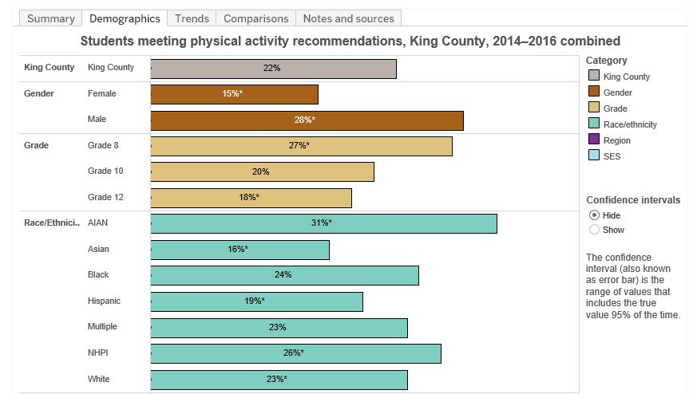
FINDING DATA TO TELL YOUR STORY
Numbers: Stories:
Maps: Pictures:
Notes:
!

Slide 12
KING COUNTY DATA RESOURCES
Best Starts for Kids Indicators: www.kingcounty.gov/bskindicators
King County population-level data about the overall goals of Best Starts for Kids

Slide 13
FOR MORE RESOURCES
Check out our webinar!
https://beststartsblog.com/2017/09/29/data-storytelling-webinar-recording/

Slide 14
ZOOMGRANTS INFO

Slide 15
Support
Technical Assistance –

Slide 16
QUESTIONS?
CONTACT US!
best.starts@kingcounty.gov
Notes:
I’m sure there will be a range of questions from formatting to submissions.
Q#1: access to ppt info? – after Oct. 30th webinar - will be posted
Q#2: Link BSK funding to other funding? – be transparent about other funding (RFP Question
Q#3: fund within Seattle City limits? – yes, will be providing contracts within City. “dead zones” will be given preferential treatment South King County plus South Seattle and West Seattle/White Center – expand beyond funded orgs to Kent, Auburn, Federal Way
Q#4: How do we help people move from talk stage to action stage? Community meetings with immigrants – not seeing action from meeting with government folks. Slowness of bureaucracy and lack of understanding re: speed of policy change. When my boss –
How do you help people who don’t understand democracy – don’t want to participate – because things take too long.
Zd: relationships with community – important – genuine relationships with community members = parents, youth – ongoing
Building confidence and hope with people who are burned out.
Building relationships with community – not just Council members – not back door process. Not how we do this.
Demonstrate relationships with community –
Q#5: RFP mentions connecting older youth to employment – what about to college?
We focus on high school and older youth
Should we focus on high school age youth – pos. cultural identity and education
Or, college age youth – retention in college –
Want to support youth who are in college
Retention is important – life happens for older youth…
What does it mean for us to support youth
“access” implied
RFP – say post-secondary
RC: Most important: Relationships, Guidance and Resources
Working with most affected youth
Provide clarification re: college age youth
Q#6: We work with marginalized youth – do they have to be youth involved in jj/prison?
Zd: no, youth don’t have to be involved in prison. Work with youth who are not involved – great – keep them going…
FWYAT – youth involved – shot before he went to college – not
Q#7: is it better to ask for lower amount than higher amount? All the grants have been more competitive – you are using social justice lens – people being funded at lower levels.
Zd: YD RFP was hard one because of large number of applicants (170 apps).
We want to make sure we are wasting your time or your wasting our time.
Zd: if you can justify why.
Will you fund for lower amounts?
Rc: funding for just training? Funding for lower amount –
Larger org. may fund another type of community support – will fund
Zc: want to fund in Kent, home grown orgs. Don’t want to see orgs in Seattle requesting $400K to work in Kent (Outreach person plus Case Manager, TA, IT, accounting, etc.) Want to support that.
Q#8: What if long term impact is beyond 18 months?
Zd: can’t make any promises beyond funding period
Working with kids who –
Some of our kids of color – opportunities in life and come back – measure outcomes
Zd: work closely with providers re: evaluation and performance measures, 1:1 conversation to measure progress. We will have contract recipients will come together to talk and discuss how we measure success.
Rc: timeline goes past that – will help evaluators to see – long term impact
Zd: review panel – robust – youth/young adults, parents, leg aides and government
Q#9: can a single org apply twice for distinct programs?
Yes, your appllications will be competing against one another in same pool. Doesn’t necessarily increase your chances.
Q#10: South Seattle? Yes
Q#11: Demographics – staff reflect demographics of community?
Zd: one of our desires is to see that change. Decision-makers do they understand and have the experience of the youth/young adults
KB: Historically Black colleges
zd: we want to know who are making decisions about program. If that is an all white group, will be a real challenge for us. Willing to provide support to diversify that group – doesn’t mean you’ll receive the contract. All too often, that means if all white group –
Rc: RFP App Qs
Q#12: Is parent involvement a fundamental part of the process?
YES! They’re involved throughout the entire process – RFP development, review, post-application, planning, etc.
Pipeline to playpen to state pen
This one talks about school – parents understand -
Community college program – parent involvement ex.
Male role models

