Slide 1
King County Best Starts for Kids 5-24 Liberation and Healing from Systemic & Internalized Racism (LHSIR) formally known as (Trauma-Informed & Restorative Practices)
January 12, 2022

Slide 2
BSK Trauma-Informed & Restorative Practices Strategy Our Journey from Awardees to The Village
Yolanda McGhee & Julia Yen

Slide 3
Our Journey From Trauma to Liberation
Trauma-Informed
ACE’s
1
The Village
3
4
5
The Power of Belief
2
Liberation and Healing
Collective Movement
Notes:
Trauma-informed (ACE’s) narrative is not strength-based – it focuses on something is wrong with an individual and let me treat ‘them’ - observe, diagnose, and prescribes the risk factors for those who experience a high ACEs score more likely to experience chronic diseases, mental illness, and violence.
For the 1.0 RFP we wanted community-based organization to see themselves in the strategy, to understand that they did not have to have commas behind their name to be qualified to serve our scholars, family and community, that lived experience was valued giving them an ACE in the hole an advantage -a WIN! In order for community to see themselves in this body of word, we coned the phase “Power of Belief” the belief that I am more than my trauma and take ownership in my healing… I wanted to use a strength based culturally responsive approach the belief that trusted adults could positively impact a scholar’s life by supporting them to see beyond their individual trauma by developing their sense of agency, identify, belongs and discovering their greatness and brilliance.
The Village focused on the impact of racial, institutional, and systemic trauma & racism. We knew to impact and dismantle systemic racism and internalize oppression we must work together. Early on decided that we would be a Village and learn to socialize and communicate like a Village and know the culture behind It became important to tell our collective counter narrative. ​
(One disclaimer) this collective approach was not in 1.0 awardees contract, so it was totally voluntarily. It was like a train, moving and everyone was on the train without knowing the destination, now the 1.0 train has stopped the next train is number 2.0 and the destination is Liberation and Healing - this time one would need to opt in to being a part of the collective movement with a clear understanding, dedication and commitment to something bigger than one’s organization to achieve evidence of collective impact on impacting scholars and communities.

Slide 4
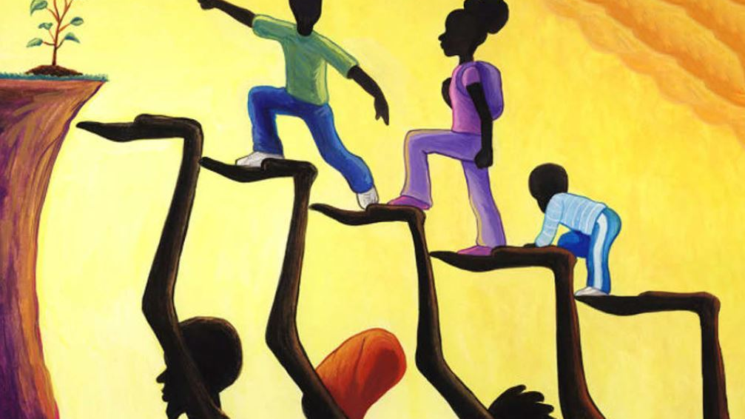
2.0 RFP
BSK 2.0 strategy Liberation and healing from systemic racism 2022
Notes:
A strategy name changed was recommended to foster align with our strategy mission and vision
Liberation and Healing from Systemic and Internalized Racism (LHSR)​ (in the school and community environment) ​

Slide 5
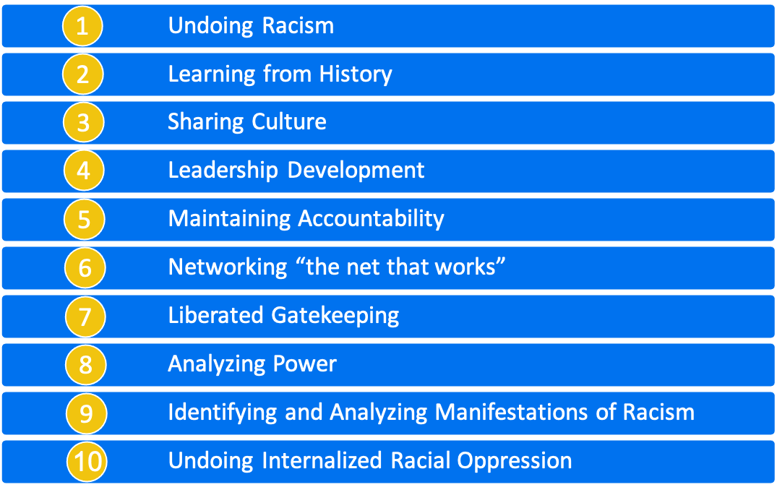
ANTI-RACIST PRINCIPLES
The Liberated Village applies the People’s Institute for Survival and Beyond Undoing Institutional Racism (UIR) social transformation
Notes:
The foundation has been built on these anti racist principles, that All stakeholders both internal and external should have a race analysis to understand how to do racial equity work.

Slide 6
KWANZAA PRINCIPLES
The Liberated Village embraces the 7 Principles aka Nguza Saba
Notes:
The Liberated Village embrace the 7 Kwanzaa Principles (aka Nguza Saba)
This is how we as a Village live out the principle of collective work and responsibility is exemplified by focusing on building and maintaining our communities while solving problems together. In response to systemic and racial trauma, the Liberated Village works in unity, cooperatively and creatively in faith and purpose.

Slide 7
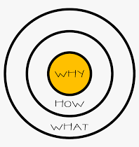
The Golden Circle
WHY
Vision: We see generation of scholar experiencing liberation and healing from system racism by living into their true cultural identity, brilliance, and purpose.
Mission: We create authentic partnerships to promote culturally responsive practices that inspires belief in the brilliance of ALL scholar.
HOW
TIRP Core Principles:
Develop skills that promote healing
Focus on the whole child
Foster collectivism and power
Lead with racial justice
WHAT
Theory of Action
Capacity Building
Cultural Identity Development
Family Leadership and Engagement
Systems Creation and Alignment
Youth Development and Leadership
Notes:
Julia – que the Video –
We believe that our ‘why’, guiding principles and core beliefs will guide the philosophy, ideology, for critical and creative thinking. We start with our ‘why’ using The Golden Circle concept developed by Simon Sinek who says, “people don't care about what you do, they care about why you do what you do.” According to Sinek, most people communicate by starting with the “what” they do aspect and eventually work their way back to talk about “how” and “why” they do what they do. We start with the ‘why’ then we will apply a result framework to the maintain alignment to guide the ‘what’ and ‘how’.
“Great leaders are in pursuit of WHY.
They hold themselves accountable to HOW to do it.
And WHAT they do, serves as the tangible proof of what they believe.”
If your ‘why’ don’t make you ‘cry’, then it’s not strong enough!
‘HOW’-Our Core Principles develop, focus, foster and lead
‘What’ -The Village collectively developed our Theory of Change (Action) though there were 30 organization awarded we defined the commonalities and originally came up with 9 TOC but now will move forward 5 TOC and as a village we will work together to community – centered solutions through collective efforts to create the processes and conditions for transformative systemic change, building capacity, developing scholars' cultural identity, family leadership and engagement and youth leadership!

Slide 8
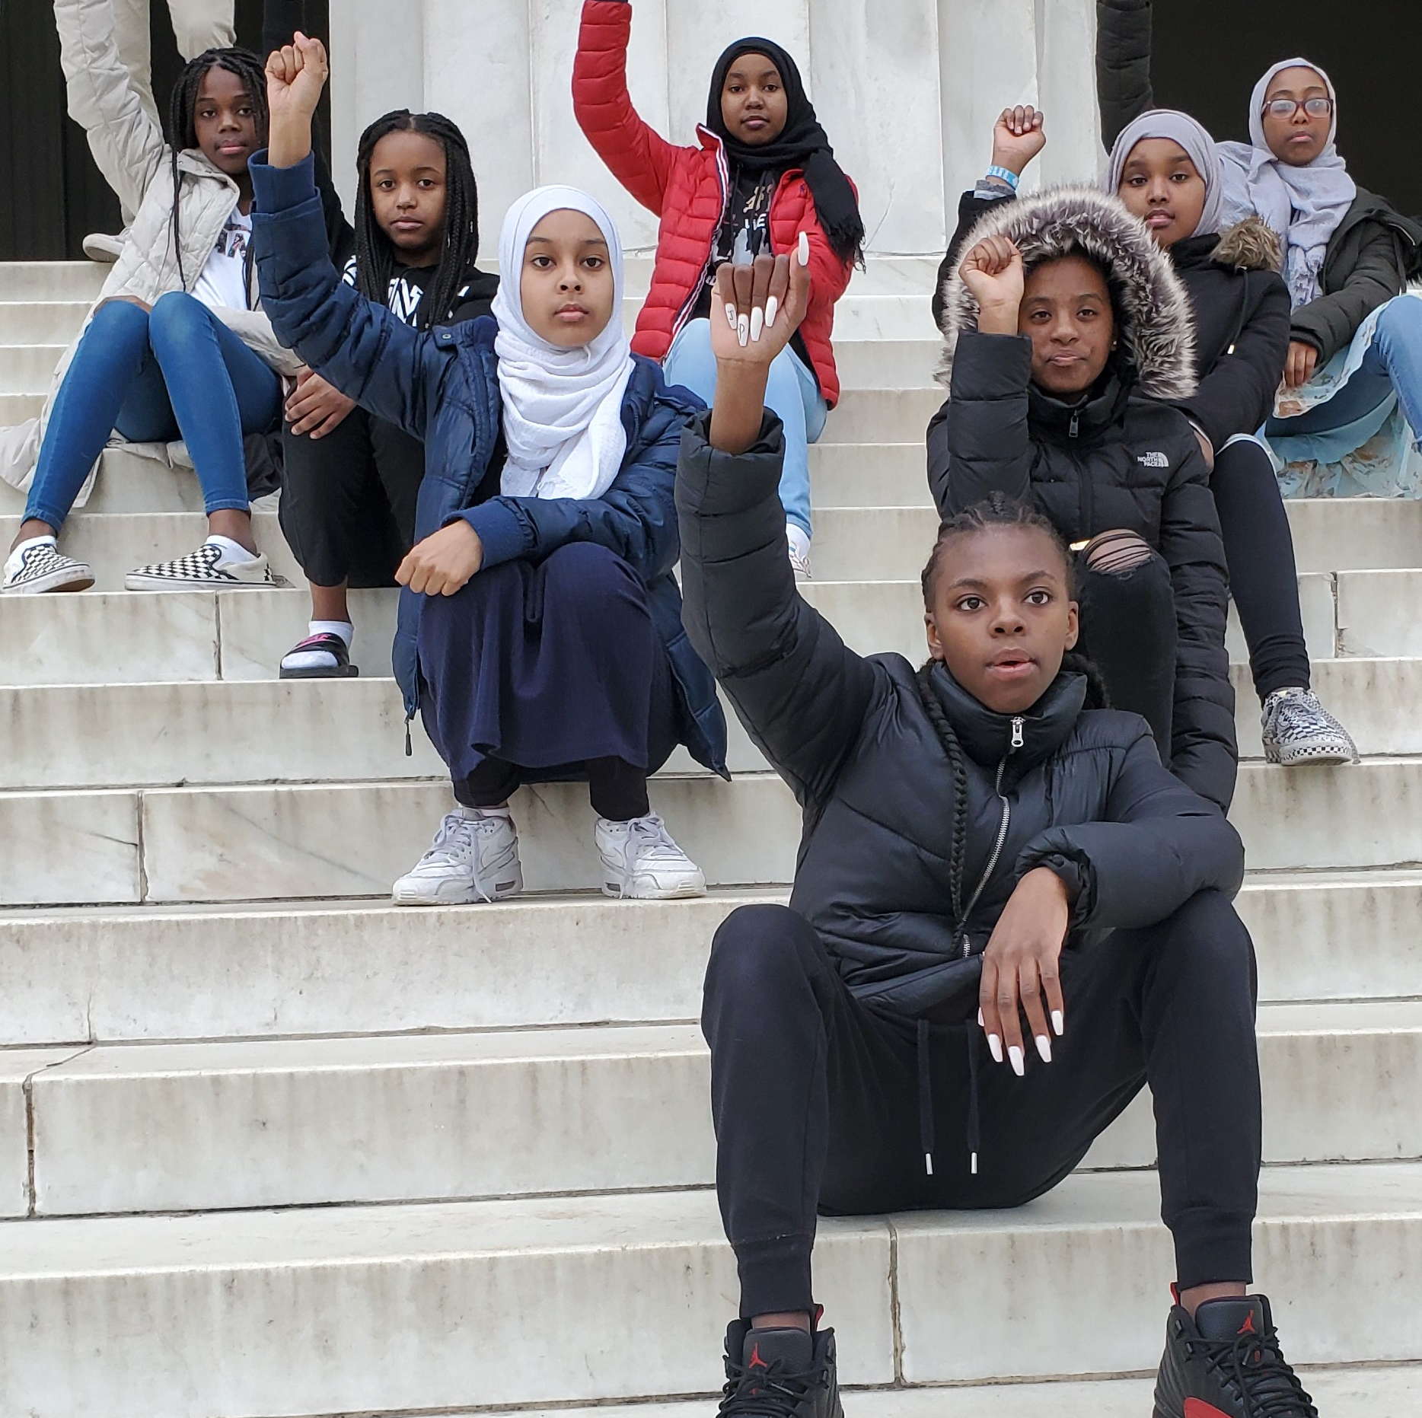
The Liberated Village Ideology
LHSIR RFP is seeking partners who opt in to a collective methodology to show evidence of collective impact.
The conditions of collective impact are having a shared vision, shared measurements, mutually reinforcing strategies, continuous communication, and a strong infrastructure for collective work.
Notes:
Explain - mutually reinforcing strategies
Theory of Action
Capacity Building
Cultural Identity Development
Family Leadership and Engagement
Systems Creation and Alignment
Youth Development and Leadership

Slide 9
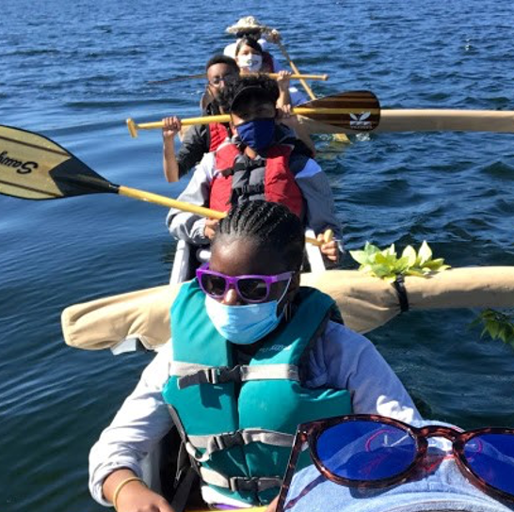
The Collective Movement
The Liberation and Healing Movement will address the educational gaps rooted in racism that has negatively contributed to black and brown scholars’ ability to thrive and succeed. Instead of partners working in isolated efforts, organization will work together towards community-centered solutions for transformative systemic change.

Slide 10
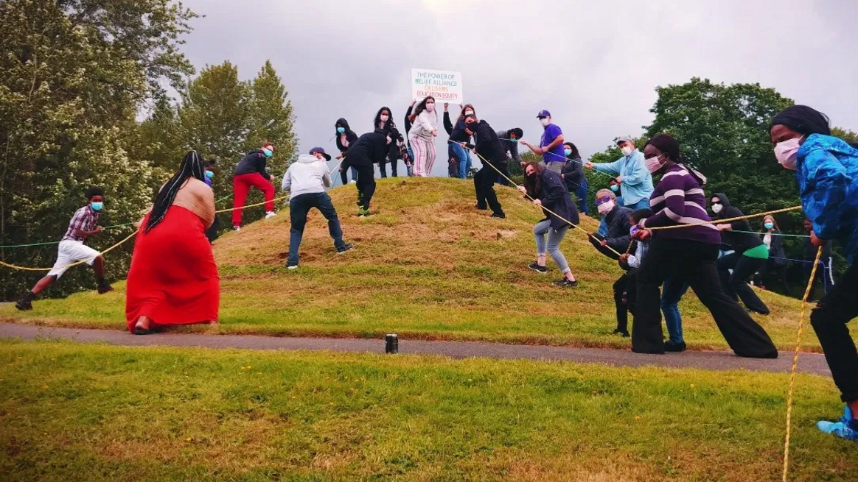
2.0 RFP Criteria
Applicant will….
demonstrate the understand of their individual ‘why’, organizational ‘why’ and how it aligns with the Liberated Village Collective Why
belief that scholars who are more likely to be marginalized can thrive when educators and service providers believe in scholars’ ability to excel and succeed
provide an environment of love and care for scholars and uplift and respect their communities’ cultures
actively confront racism and other structures of systemic oppression that perpetuate generational trauma
demonstrate the ability to support children/scholars developed of a positive culture identity, strong agency, and ongoing affirmations (rites of passage) that builds scholars confidence and is shown in their ability to excel in their academic success
a desire to work collectively with other Liberated Village member(s) to provide adaptive solutions to meet the needs of scholars, families, and communities to support their ability to thrive and experience liberation in scholars and families' lives.
work to build excellence as an organization or institution

Slide 11
collective work and responsibility
Applicants have culturally responsive curriculum and demonstrate the ability to work collectively with other organizations and subject matter experts to provide excellence in the areas of liberation, such as the following:
Economic Intelligence
Entrepreneurship
Financial & Real-Estate Literacy
Skilled Trades Exposure and Development
Technology Skill Development
Urban Cultivation Intelligence
Farm to table
Organic gardening
Sustainable food and farming
Health & Wellness Intelligence
Food/Nutrition
Fitness & Conditioning
Mental Wellbeing - Clarity of Mind, body, Soul & Spirit
Social and Emotional Intelligence
Educational Intelligence
Academic Enrichment
Youth Arts & Expression
Additional Partners to consider
Home School Leaders
Recreational Institutions
Religious Institutions
School Institutions
Notes:
JY
Pool of options to think about as you are thinking of about partners Ideas on how to think about partnerships how to integrate outside experts into your program to make the coooected around them. The concept of one body with many members to achieve the evidence of collective impact. The net-that-works!

Slide 12
RELATIONSHIPS OF ENGAGEMENT
Notes:
Return on Relationship (ROR) is the key factor that determines success!

Slide 13
2.0 RFP LHSIR Eligibility
Additional Partners to Consider
Parent/Guardians and Parent Groups
Partner with other Community-Based Organizations
Homeschool Network K-12
Eligible as Lead Applicants: Grassroot organizations i.e., service providers, mentors’ trusted adults, community members and leaders, coaches, faith-based organization, community organizations, parent-led groups, small for-profit BIPOC-led organizations, and home-school providers
Non-Eligible as Lead Applicants: School/District & Early Learning
Religious Institutions
Partnering with Subject Matter Experts
Notes:
JY 2.0 will be intentional about putting the dollars in communities. For the people by the people in partnership with schools/district who have a shared vision to see scholars experience liberation and healing.
COVID-19 has taught us to expand partnership: beyond the boundaries of the school environment.
Community-to-community organizations (working together to support families/scholars)
Parents/Guardians as partners
It has also taught us to expand delivery of services methods beyond the school day, to home school networks, online school, after school, weekend school, summer school , etc.
Early Learning (in particular – Preschool Investments) BSK has increased during this 6-year Levy cycle, we encourage all organizations that serve the prenatal-5 apply for those investment areas.
Schools/Districts have stricter policies around spending dollars with communities (partners), scholars, and families.

Slide 14
Applicant commitment
Applicant will show commitment to breaking the silos of individualism, challenge one’s own systems of belief by creating and sustaining relationship and partnership with schools, families and other stakeholders.
Have the capacity to learn, unlearn, relearn, and apply action to achieve evidence of collective impact.
Applicant willing to share resources in order to maintain a collective vision, collective work and responsibility (Ujima), co-create and drive transformation regularly participating in learning cohorts with other awardees to pull resources, services, expertise, knowledge, and assets making it available to the Liberated Village.

Slide 15
Applicant commitment
Applicant will commit to working collectively with subject matter experts in the areas of project management, finance operations, evaluation and programing
Applicant will participate in BSK & Liberated Village Professional Development Opportunities:
BSK Onboarding/Orientation, Finance Requirements and compliance, Evaluation & Research Trainings, Project Management Skill Development, etc.
Applicant will enroll in BSK Free Capacity Building Trainings that most interest your organization personal/professional improvement and growth.
Applicant will collect and report collective performance measure data as defined by the Liberated Village in partnership with BSK.

Slide 16
SCHOLARS commitment
Scholars willing to participate in the Liberated Village Scholars Program
Each scholar will develop a Goal with the guidance from the organization and measure outcomes.
Scholars willing to attend a monthly Liberated Village Brilliant Scholars Academy hosted by the Parents as Partners Leadership Committee and Learning and Action Cohort (LAC).
Scholars provide quarterly pre/post survey(s) to support the (LV) performance measurement.
Notes:
The goal is to connect scholars across all programing be feel like they are apart of something greater than one organization – they have a VILLAGE!

Slide 17
School Partners Commitment
Schools/Districts who identify themselves as Liberated Gatekeepers, shall partner with communities (Not ‘to’, Not ‘for’, but ‘With) in trusted relationship with community and parent partners.
School partners shall have a school liaison to engage with community partners and the Liberated Village, Schools/District will work with organization to create their MOU and data sharing agreements.
Notes:
i.e., attend semi-quarterly education experiences, participate in monthly partner meetings at the school level, provide partners with a list of scholars to join the Liberated Village Scholars Program, and provide scholars data for evaluation purposes upon partners completion of district data agreement.
MOU? Memorandum of Understanding
Data sharing agreement – agreement between school/district and community-based organization that gives organization access to scholars' information (i.e., attendance, academic, etc.)
Why they are important because you will act as a liaison between school and home and this will give you leverage to advocate for schools and help you measure success from the support the LV provides.
Post awardee – Letter agreement (requirement)
Encourge- if you don’t have a partnership – please articulate your plan for developing

Slide 18
Parent/Guardian Commitment
Parent permission form and enrollment of their scholars is required
Applicant willing to recruit/enroll parents into the Bi-Monthly Workshops Liberated Village Parent University, content and guest speakers will be defined by the Learning and Action Cohort (LAC).

Slide 19
Liberation and Healing from Systemic and Internalized Racism (LHSIR) 2.0 RFP 2022
Name Change from Liberation and Healing from Systemic and Internalized Racism
1
2.0 RFP
Approximately
4 Million Per Year
for 5.5 Years
3
4
5
Collective Work and Responsibility (Ujima)
Building and maintain our community-solving problems together
2
3 years Contract period
with potential to extend for those in good standing
Approximately
14-16 contracts,
Up to $300,000 per year
Notes:
JY Summary -

Slide 20
2.0 RFP Tentative Projection
RFP Issued | March 16, 2022
Information Session 1 (recorded) | March 22, 2022
Information Session 2 (recorded) | April 5, 2022
Final Day to Ask King County Questions | April 29, 2022
Final Day to Request TA | May 2, 2022
RFP Application Due | May 6, 2022 (5PM PST)
Responses Reviewed and Rated | May 11 – June 17
Notice of Selected and Non-Selected Proposals | June 23, 2022
Selected Proposals List Published | June 30, 2022
Contract negotiation | July
Contracts begin | August 1, 2022
Notes:
JY

Slide 21
Where do I go from here…… Kujichagulia (Self/Collective Determination)
Are you willing to go beyond collaboration to work collectively to experience collective impact?
How might your personal and organizational "why" be connected and aligned with the Village collective "why"?
Think about the relationships you have (ROR) and how they have contributed to you, your organization and the community's growth.
Think about ways you can partner with other to provide a greater impact on scholar's trajectory!
Start developing a SMART goals together in preparation for the launch of the 2.0 LHSIR RFP.
Notes:
JY que up the video George C Fraser Connecting the Dots
https://www.youtube.com/watch?v=Dr2Cyl_mjVk
Ask yourself these questions:
Do I see myself in the Collective Movement!

